Slide 1



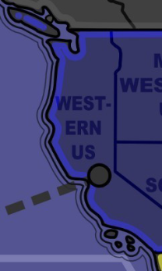
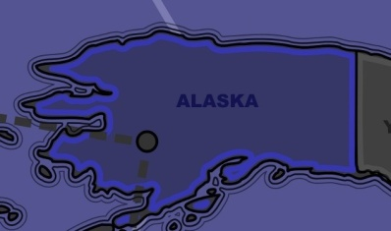

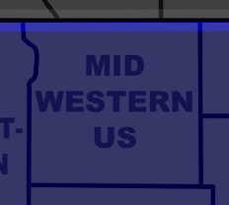
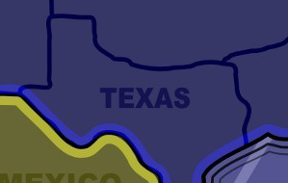
Make sure you select ‘scale to fit paper’ when printing
N. AMERICA
1 of 12
N. AMERICA
2 of 12
WESTERN US
ALASKA
N. AMERICA
3 of 12
N. AMERICA
4 of 12
MID WESTERN US
TEXAS
Cut out cards with backs and fronts attached, then fold over and insert inside card protector for Magic or Yugioh.

Slide 2
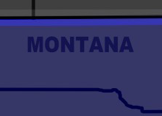
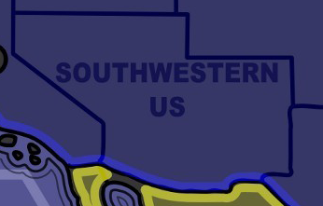
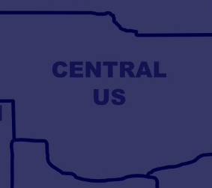
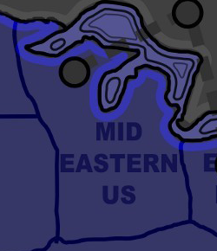
N. AMERICA
5 of 12
N. AMERICA
6 of 12
MONTANA
SOUTHWESTERN US
N. AMERICA
7 of 12
N. AMERICA
8 of 12
CENTRAL USA
MID EASTERN US

Slide 3
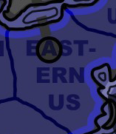


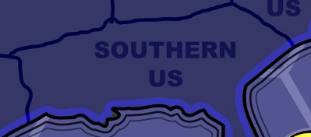
N. AMERICA
9 of 12
N. AMERICA
10 of 12
EASTERN US
NORTHERN US
N. AMERICA
11 of 12
N. AMERICA
12 of 12
SOUTHERN US
HAWAII

Slide 4
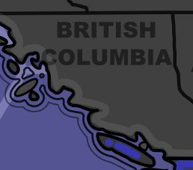
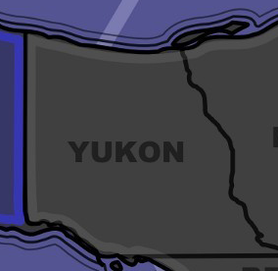
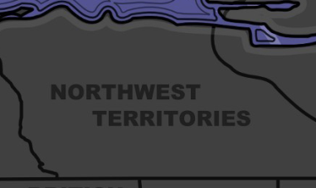

CANADA
1 of 11
CANADA
2 of 11
BRITISH COLUMBIA
YUKON
CANADA
3 of 11
CANADA
4 of 11
NORTHWEST TERRITORIES
NUNAVUT

Slide 5
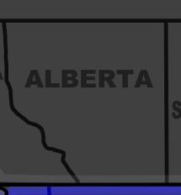

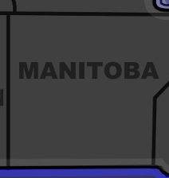

CANADA
5 of 11
CANADA
6 of 11
ALBERTA
SASKATCHEWAN
CANADA
7 of 11
CANADA
8 of 11
MANITOBA
ONTARIO

Slide 6


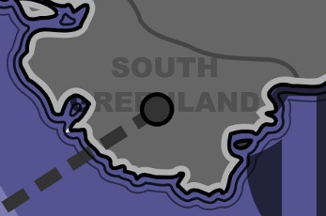

CANADA
9 of 11
CANADA
10 of 11
QUEBEC
NOVA SCOTIA
CANADA
11 of 11
ANTARCTIC/GREENLAND
1 of 7
SOUTH GREENLAND
NEWFOUNDLAND

Slide 7
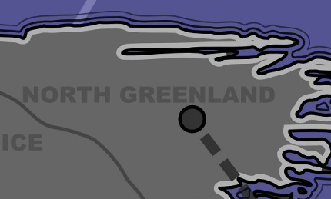

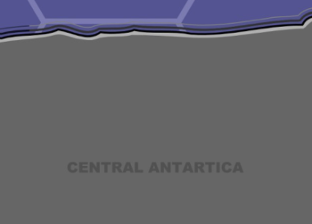

ANTARCTIC/GREENLAND
2 of 7
ANTARCTIC/GREENLAND
3 of 7
GREENLAND ICE SHELF
NORTH GREENLAND
ANTARCTIC/GREENLAND
4 of 7
ANTARCTIC/GREENLAND
5 of 7
CENTRAL ANTARCTICA
ANTARCTICA

Slide 8
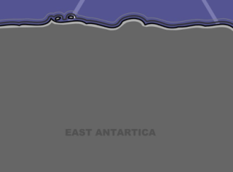


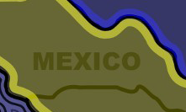
ANTARCTIC/GREENLAND
6 of 7
ANTARCTIC/GREENLAND
7 of 7
EAST ANTARCTICA
WEST ANTARCTICA
CENTRAL AMERICA
1 of 13
CENTRAL AMERICA
2 of 13
BAJA CALIFORNIA
MEXICO

Slide 9
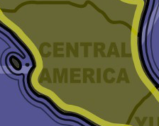

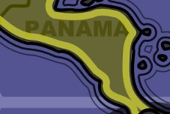

CENTRAL AMERICA
3 of 13
CENTRAL AMERICA
4 of 13
CENTRAL AMERICA
YUKATAN
CENTRAL AMERICA
5 of 13
CENTRAL AMERICA
6 of 13
PANAMA
GALAPAGOS

Slide 10
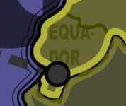
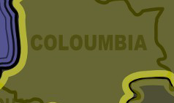


CENTRAL AMERICA
7 of 13
CENTRAL AMERICA
8 of 13
EQUADOR
COLUMBIA
CENTRAL AMERICA
9 of 13
CENTRAL AMERICA
10 of 13
VENEZUELA
CARRIBEAN ISLANDS

Slide 11




CENTRAL AMERICA
11 of 13
CENTRAL AMERICA
12 of 13
CUBA
BAHAMAS
CENTRAL AMERICA
13 of 13
OCEANIA
1 of 10
DOMINICAN REPUBLIC
TOKELU

Slide 12




OCEANIA
2 of 10
OCEANIA
3 of 10
SAMOA
MARQUESAS
OCEANIA
4 of 10
OCEANIA
5 of 10
FIJI
TONGA

Slide 13



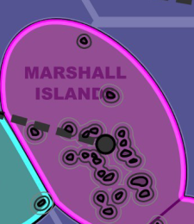
OCEANIA
6 of 10
OCEANIA
7 of 10
COOK ISLANDS
FRENCH POLYNESIA
OCEANIA
8 of 10
OCEANIA
9 of 10
MARSHALL ISLANDS
MARIANA ISLANDS

Slide 14

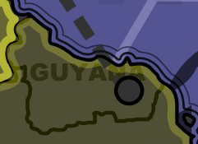
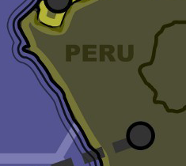

OCEANIA
10 of 10
S. AMERICA
1 of 16
FRIBATI
GUYANA
S. AMERICA
2 of 16
S. AMERICA
3 of 16
AMAZON
PERU

Slide 15
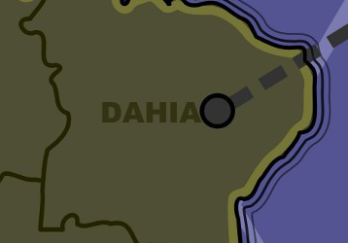
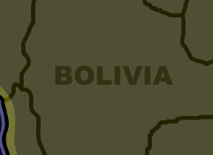


S. AMERICA
4 of 16
S. AMERICA
5 of 16
DAHIA
BOLIVIA
S. AMERICA
6 of 16
S. AMERICA
7 of 16
CENTRAL BRAZIL
PARAGUAY

Slide 16
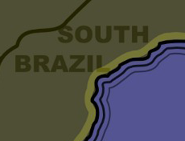

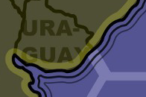
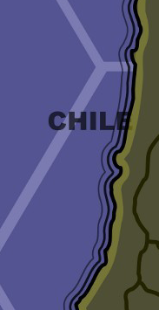
S. AMERICA
8 of 16
S. AMERICA
9 of 16
SOUTH BRAZIL
SALTA
S. AMERICA
10 of 16
S. AMERICA
11 of 16
CHILE
URAGUAY

Slide 17
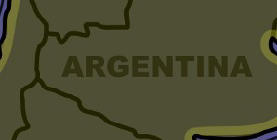



S. AMERICA
12 of 16
S. AMERICA
13 of 16
ARGENTINA
SANTA CRUZ
S. AMERICA
14 of 16
S. AMERICA
15 of 16
FALKLAND ISLANDS
SOUTH GEORGIA

Slide 18


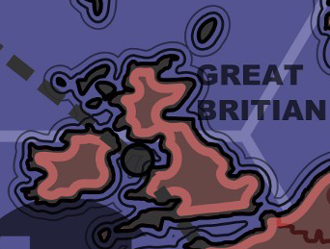
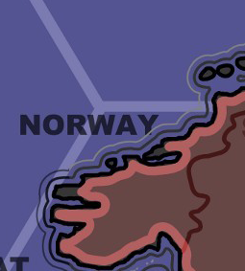
S. AMERICA
16 of 16
EUROPE
1 of 19
SOUTH SANDWICH ISLANDS
ICELAND
EUROPE
2 of 19
EUROPE
3 of 19
GREAT BRITAIN
NORWAY

Slide 19
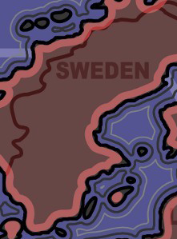
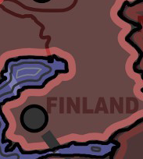
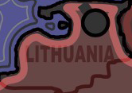

EUROPE
4 of 19
EUROPE
5 of 19
SWEDEN
FINLAND
EUROPE
6 of 19
EUROPE
7 of 19
SVALBARD
LITHUANIA

Slide 20


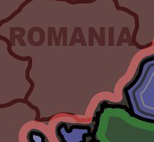
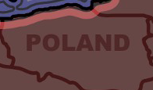
EUROPE
8 of 19
EUROPE
9 of 19
UKRAINE
BELARUS
EUROPE
10 of 19
EUROPE
11 of 19
POLAND
ROMANIA

Slide 21

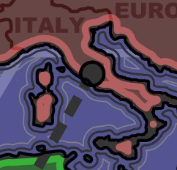
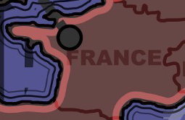
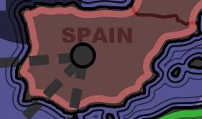
EUROPE
12 of 19
EUROPE
13 of 19
CENTRAL EUROPE
ITALY
EUROPE
14 of 19
EUROPE
15 of 19
FRANCE
SPAIN

Slide 22
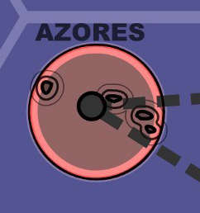
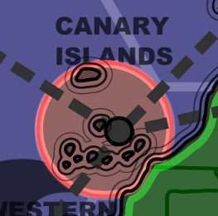
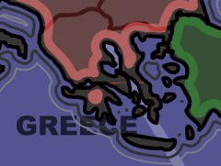
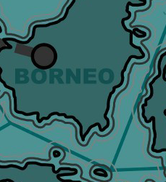
EUROPE
16 of 19
EUROPE
17 of 19
AZORES
CANARY ISLANDS
EUROPE
18 of 19
AUSTRALIA
1 of 18
BORNEO
GREECE

Slide 23
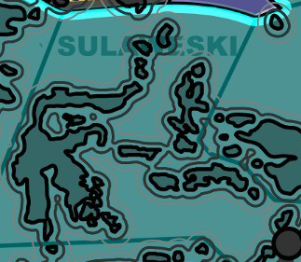

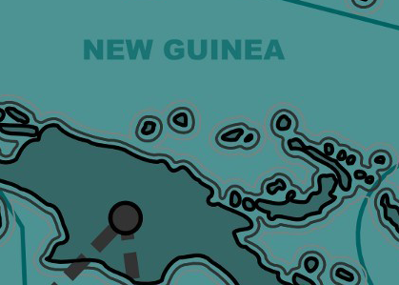
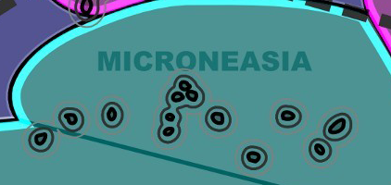
AUSTRALIA
2 of 18
AUSTRALIA
3 of 18
SULAWESKI
PALAU
AUSTRALIA
4 of 18
AUSTRALIA
5 of 18
MICRONEASIA
NEW GUINEA

Slide 24




AUSTRALIA
6 of 18
AUSTRALIA
7 of 18
SOLOMON ISLANDS
JAVA
AUSTRALIA
8 of 18
AUSTRALIA
9 of 18
NEW CALEDONIA
VANUATU

Slide 25




AUSTRALIA
10 of 18
AUSTRALIA
11 of 18
NORTHERN AUSTRAILIA
WESTERN AUSTRALIA
AUSTRALIA
12 of 18
AUSTRALIA
13 of 18
SOUTH AUSTRALIA
QUEENSLAND

Slide 26




AUSTRALIA
14 of 18
AUSTRALIA
15 of 18
NEW SOUTH WALES
VICTORIA
AUSTRALIA
16 of 18
AUSTRALIA
17 of 18
TAZMANIA
NEW ZEALAND

Slide 27




AUSTRALIA
18 of 18
CHINA
1 of 11
SUMATRA
HEI-LONG-JIANG
CHINA
2 of 11
CHINA
3 of 11
INNER MONGOLIA
SHAN-DONG

Slide 28




CHINA
4 of 11
CHINA
5 of 11
GUANGDONG
HENAN
CHINA
6 of 11
CHINA
7 of 11
CHONG-QUING
QUINGHAI

Slide 29




CHINA
8 of 11
CHINA
9 of 11
SICHUAN
GUANXI
CHINA
10 of 11
CHINA
11 of 11
TIBET
XINJIANG

Slide 30




EAST ASIA
1 of 16
EAST ASIA
2 of 16
NORTH JAPAN
JAPAN
EAST ASIA
3 of 16
EAST ASIA
4 of 16
SOUTH JAPAN
KOREA

Slide 31




EAST ASIA
5 of 16
EAST ASIA
6 of 16
BONIN ISLANDS
RYU KYU ISLANDS
EAST ASIA
7 of 16
EAST ASIA
8 of 16
TAIWAN
PHILLIPINE ISLANDS

Slide 32




EAST ASIA
9 of 16
EAST ASIA
10 of 16
MALASIA
THAILAND
EAST ASIA
11 of 16
EAST ASIA
12 of 16
VIETNAM
LAOS

Slide 33




EAST ASIA
13 of 16
EAST ASIA
14 of 16
MYANMAR
BANGLADESH
EAST ASIA
15 of 16
EAST ASIA
16 of 16
EAST MONGOLIA
WEST MONGOLIA

Slide 34




WEST ASIA
1 of 16
WEST ASIA
2 of 16
UZBEKISTAN
WEST KAZAKHSTAN
WEST ASIA
3 of 16
WEST ASIA
4 of 16
EAST KAZAKHSTAN
KARAGANDY

Slide 35




WEST ASIA
5 of 16
WEST ASIA
6 of 16
TAJIKISTAN
TURKMENISTAN
WEST ASIA
7 of 16
WEST ASIA
8 of 16
GEORGIA
IRAN

Slide 36




WEST ASIA
9 of 16
WEST ASIA
10 of 16
KERMAN
AFGHANISTAN
WEST ASIA
11 of 16
WEST ASIA
12 of 16
PAKISTAN
NORTH INDIA

Slide 37




WEST ASIA
13 of 16
WEST ASIA
14 of 16
EAST INDIA
SOUTH INDIA
WEST ASIA
15 of 16
WEST ASIA
16 of 16
CHAGOS ARCHIPAGO
MALDIVES

Slide 38




MIDDLE EAST
1 of 9
MIDDLE EAST
2 of 9
TURKEY
JORDAN
MIDDLE EAST
3 of 9
MIDDLE EAST
4 of 9
IRAQ
ISRAEL

Slide 39




MIDDLE EAST
5 of 9
MIDDLE EAST
6 of 9
SAUDI ARABIA
AR RIYADH
MIDDLE EAST
7 of 9
MIDDLE EAST
8 of 9
YEMEN
EASTERN ARABIA

Slide 40




MIDDLE EAST
9 of 9
NORTH AFRICA
1 of 16
OMAN
CAPE VERDE
NORTH AFRICA
2 of 16
NORTH AFRICA
3 of 16
WESTERN
SAHARA
MAURITANIA

Slide 41




NORTH AFRICA
4 of 16
NORTH AFRICA
5 of 16
MALI
ADRAR
NORTH AFRICA
6 of 16
NORTH AFRICA
7 of 16
MOROCCO
ALGERIA

Slide 42




NORTH AFRICA
8 of 16
NORTH AFRICA
9 of 16
NIGER
LIBIA
NORTH AFRICA
10 of 16
NORTH AFRICA
11 of 16
CHAD
EGYPT

Slide 43




NORTH AFRICA
12 of 16
NORTH AFRICA
13 of 16
DARFUR
NORTH SUDAN
NORTH AFRICA
14 of 16
NORTH AFRICA
15 of 16
SOMOLIA
SOUTH SUDAN

Slide 44




NORTH AFRICA
16 of 16
SOUTH AFRICA
1 of 23
SEYCHELLES
GUINEA
SOUTH AFRICA
2 of 23
SOUTH AFRICA
3 of 23
GHANA
COTE D’IVOIRE

Slide 45




SOUTH AFRICA
4 of 23
SOUTH AFRICA
5 of 23
NIGERIA
CAMEROON
SOUTH AFRICA
6 of 23
SOUTH AFRICA
7 of 23
CENTRAL AFRICA
ETHIOPIA

Slide 46




SOUTH AFRICA
8 of 23
SOUTH AFRICA
9 of 23
GABON
CONGO
SOUTH AFRICA
10 of 23
SOUTH AFRICA
11 of 23
UGANDA
KENYA

Slide 47




SOUTH AFRICA
12 of 23
SOUTH AFRICA
13 of 23
TANZANIA
HAUT LOMAMI
SOUTH AFRICA
14 of 23
SOUTH AFRICA
15 of 23
ANGOLA
ZAMBIA

Slide 48




SOUTH AFRICA
16 of 23
SOUTH AFRICA
17 of 23
MOZAMBIQUE
ZIMBABWE
SOUTH AFRICA
18 of 23
SOUTH AFRICA
19 of 23
NAMBIA
BOTSWANA

Slide 49




SOUTH AFRICA
20 of 23
SOUTH AFRICA
21 of 23
SOUTH AFRICA
MADAGASCAR
SOUTH AFRICA
22 of 23
SOUTH AFRICA
23 of 23
COMOROS
MAURITIUS

Slide 50




RUSSIA
1 of 34
RUSSIA
2 of 34
MURMANSK
KURSK
RUSSIA
3 of 34
RUSSIA
4 of 34
KARELIA
MOSCOW

Slide 51




RUSSIA
5 of 34
RUSSIA
6 of 34
SLOVETSKI
MORDOVIA
RUSSIA
7 of 34
RUSSIA
8 of 34
VOLVOLGRAD
STRAVOPOL

Slide 52




RUSSIA
9 of 34
RUSSIA
10 of 34
ARKHANGELSK
KOMI REPUBLIC
RUSSIA
11 of 34
RUSSIA
12 of 34
VOLGA DISTRICT
PERM KRAI

Slide 53




RUSSIA
13 of 34
RUSSIA
14 of 34
YAMALIA
SVERD LOVOSK
RUSSIA
15 of 34
RUSSIA
16 of 34
TYUMEN
URAL

Slide 54




RUSSIA
17 of 34
RUSSIA
18 of 34
ALTAI
SIBERIA
RUSSIA
19 of 34
RUSSIA
20 of 34
KRASNOYARSK
BURYATIA

Slide 55




RUSSIA
21 of 34
RUSSIA
22 of 34
ZABAYKALSAY
IRKUTSK
RUSSIA
23 of 34
RUSSIA
24 of 34
YAKUTIA
AMUR

Slide 56




RUSSIA
25 of 34
RUSSIA
26 of 34
KAHBAROVSK
OBLAST
RUSSIA
27 of 34
RUSSIA
28 of 34
BRIMORSKY
YAKUTSK

Slide 57




RUSSIA
29 of 34
RUSSIA
30 of 34
NOVOSIBIRSKIY
SAKHA
RUSSIA
31 of 34
RUSSIA
32 of 34
MAGADAN
KAMCHATKA

Slide 58



RUSSIA
33 of 34
RUSSIA
34 of 34
SREDNEKOLYMSK
CHUKOTKA
EUROPE
19 of 19
GERMANY

Slide 63

MISSION 1
MISSION 2
To win, conquer North America, South America, Australasia, and a fourth continent of your choice.
To win, conquer North America, North Africa, East Asia and a fourth continent of your choice.
MISSION 3
MISSION 4
To win, conquer Russia, Australasia and Central America.
To win, conquer Russia, South America and the Middle East.

Slide 64


MISSION 5
MISSION 6
To win, conquer Europe, Australasia, Central America and West Asia.
To win, conquer Europe, South America, Antarctica-Greenland and West Asia.
MISSION 7
MISSION 8
To win, you must destroy the yellow army. If you are the yellow army or another player completes your mission, instead conquer 140 territories.
To win, you must destroy the black army. If you are the black army or another player completes your mission, instead conquer 140 territories.

Slide 65






MISSION 9
MISSION 10
To win, you must destroy the green army. If you are the green army or another player completes your mission, instead conquer 140 territories.
To win, you must destroy the grey army. If you are the grey army or another player completes your mission, instead conquer 140 territories.
MISSION 11
MISSION 12
To win, you must destroy the terracotta army. If you are the terracotta army or another player completes your mission, instead conquer 140 territories.
To win, you must destroy the salmon army. If you are the salmon army or another player completes your mission, instead conquer 140 territories.

Slide 66
MISSION 13
MISSION 14
To win, you must conquer 100 territories with at least 3 men on each.
To win, you must conquer 140 territories.

